Slide 1
A complete guide to programming in c++
Chapter 2

Slide 2
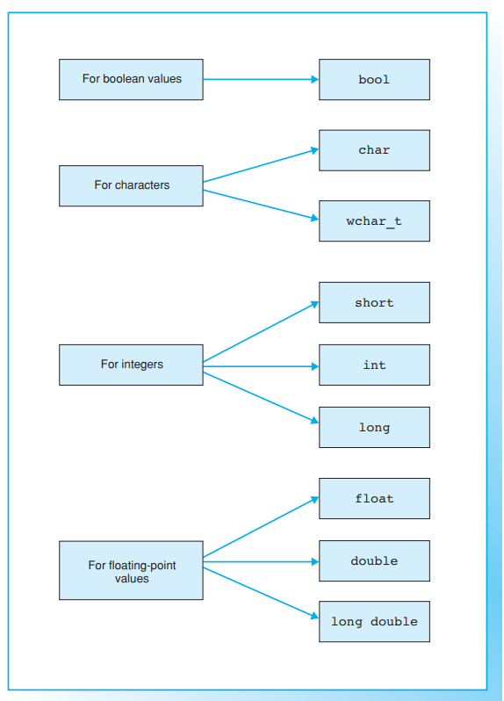
Fundamental types, constants, and variables
A program can use several data to solve a given problem, for example, characters, integers, or floating-point numbers. Since a computer uses different methods for processing and saving data, the data type must be known.
The type defines
1. the internal representation of the data, and
2. the amount of memory to allocate.
A number such as -1000 can be stored in either 2 or 4 bytes. When accessing the part of memory in which the number is stored, it is important to read the correct number of bytes. Moreover, the memory content, that is the bit sequence being read, must be interpreted correctly as a signed integer.
The C++ compiler recognizes the fundamental types, also referred to as built-in types, shown on the opposite page, on which all other types (vectors, pointers, classes, ...) are based.

Slide 3
The type bool
The result of a comparison or a logical association using AND or OR is a boolean value, which can be true or false.
C++ uses the bool type to represent boolean values.
An expression of the type bool can either be true or false, where the internal value for true will be represented as the numerical value 1 and false by a zero

Slide 4
The char and wchar_t Types
These types are used for saving character codes.
A character code is an integer associated with each character. The letter A is represented by code 65, for example.
The character set defines which code represents a certain character.
When displaying characters on screen, the applicable character codes are transmitted and the “receiver,” that is the screen, is responsible for correctly interpreting the codes.
The char (character) type is used to store character codes in one byte (8 bits). This amount of storage is sufficient for extended character sets, for example, the ANSI character set that contains the ASCII codes and additional characters such as German umlauts.
The wchar_t (wide character type) type comprises at least 2 bytes (16 bits) and is thus capable of storing modern Unicode characters. Unicode is a 16-bit code also used in Windows NT and containing codes for approximately 35,000 characters in 24 languages

Slide 5
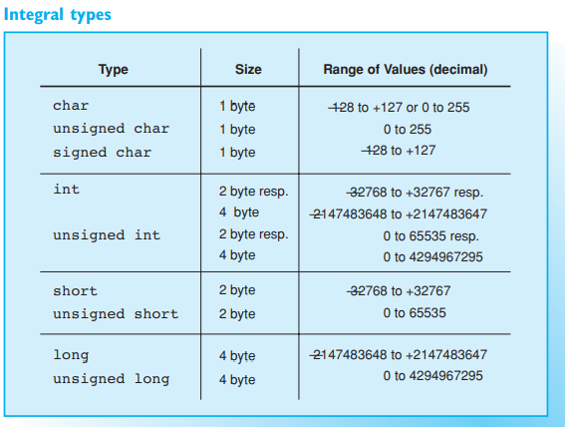
Integral types
The types short, int, and long are available for operations with integers. These types are distinguished by their ranges of values
The int (integer) type is tailor-made for computers and adapts to the length of a register on the computer. For 16-bit computers, int is thus equivalent to short, whereas for 32-bit computers int will be equivalent to long.
C++ treats character codes just like normal integers. This means you can perform calculations with variables belonging to the char or wchar_t types in exactly the same way as with int type variables. char is an integral type with a size of one byte. The range of values is thus –128 to +127 or from 0 to 255, depending on whether the compiler interprets the char type as signed or unsigned. This can vary in C++
The wchar_t type is a further integral type and is normally defined as unsigned short.

Slide 6
The signed and unsigned Modifiers
The short, int, and long types are normally interpreted as signed with the highest bit representing the sign. However, integral types can be preceded by the keyword unsigned. The amount of memory required remains unaltered but the range of values changes due to the highest bit no longer being required as a sign. The keyword unsigned can be used as an abbreviation for unsigned int
The char type is also normally interpreted as signed. Since this is merely a convention and not mandatory, the signed keyword is available. Thus three types are available: char, signed char, and unsigned char.
The current value ranges are available in the climits header file. This file defines constants such as CHAR_MIN, CHAR_MAX, INT_MIN, and INT_MAX, which represent the smallest and greatest possible values. The program on the opposite page outputs the value of these constants for the int and unsigned int types

Slide 7
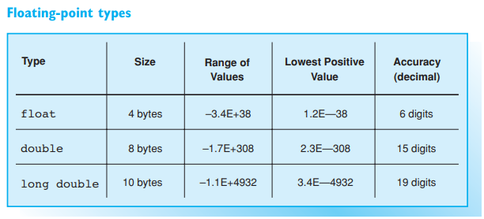
Floating-point types
Numbers with a fraction part are indicated by a decimal point in C++ and are referred to as floating-point numbers. In contrast to integers, floating-point numbers must be stored to a preset accuracy. The following three types are available for calculations involving floating-point numbers:
float for simple accuracy
double for double accuracy
long double for high accuracy

Slide 8
FLOATING-POINT TYPES
Accuracy is expressed in decimal places. This means that “six decimal places” allows a programmer to store two floating-point numbers that differ within the first six decimal places as separate numbers. In reverse, there is no guarantee that the figures 12.3456 and 12.34561 will be distinguished when working to a accuracy of six decimal places. And remember, it is not a question of the position of the decimal point, but merely of the numerical sequence
If it is important for your program to display floating-point numbers with an accuracy supported by a particular machine, you should refer to the values defined in the cfloat header file

Slide 9
The sizeof operator
The amount of memory needed to store an object of a certain type can be ascertained using the sizeof operator:
sizeof(name)
yields the size of an object in bytes, and the parameter name indicates the object type or the object itself. For example, sizeof(int) represents a value of 2 or 4 depending on the machine. In contrast, sizeof(float) will always equal 4

Slide 10
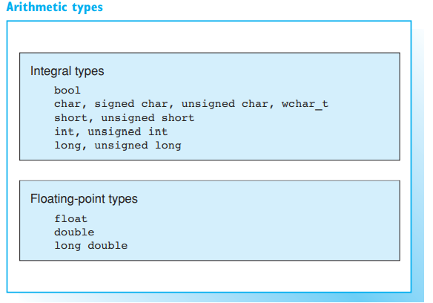
Classification
The fundamental types in C++ are integer types, floating-point types, and the void type. The types used for integers and floating-point numbers are collectively referred to as arithmetic types, as arithmetic operators are defined for them
The void type is used for expressions that do not represent a value. A function call can thus take a void type.

Slide 11

constants
The boolean keywords true and false, a number, a character, or a character sequence (string) are all constants, which are also referred to as a literals.
Constants can thus be subdivided into
boolean constants
numerical constants
character constants
string constants.

Slide 12
Boolean Constants
A boolean expression can have two values that are identified by the keywords true and false.
Both constants are of the bool type.
They can be used, for example, to set flags representing just two states

Slide 13
Integral Constants
Integral numerical constants can be represented as simple decimal numbers, octals, or hexadecimals:
a decimal constant (base 10) begins with a decimal number other than zero, such as 109 or 987650
an octal constant (base 8) begins with a leading 0, for example 077 or 01234567
a hexadecimal constant (base 16) begins with the character pair 0x or 0X, for example 0x2A0 or 0X4b1C. Hexadecimal numbers can be capitalized or noncapitalized

Slide 14
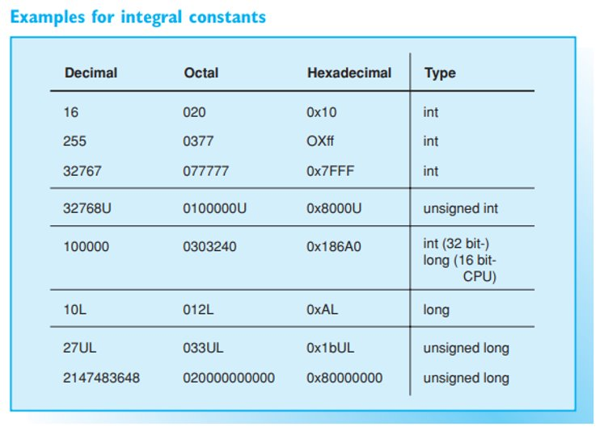
Integral Constants
Integral constants are normally of type int. If the value of the constant is too large for the int type, a type capable of representing larger values will be applied. The ranking for decimal constants is as follows:
int, long, unsigned long
You can designate the type of a constant by adding the letter L or l (for long), or U or u (for unsigned). For example,
2L and 12l correspond to the type long
12U and 12u correspond to the type unsigned int
12UL and 12ul correspond to the type unsigned long

Slide 15
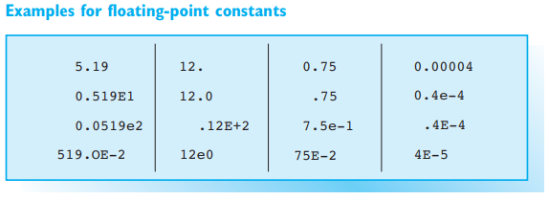
Floating-Point Constants
Floating-point numbers are always represented as decimals, a decimal point being used to distinguish the fraction part from the integer part. However, exponential notation is also permissible
EXAMPLES: 27.1 1.8E–2 // Type: double
Here, 1.8E–2 represents a value of 1.8*10^–2.
E can also be written with a small letter e. A decimal point or E (e) must always be used to distinguish floating-point constants from integer constants.
Floating-point constants are of type double by default. However, you can add F or f to designate the float type, or add L or l for the long double type.

Slide 16
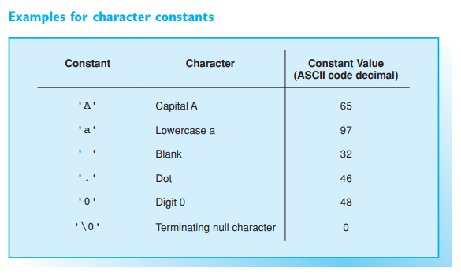
Character Constants
A character constant is a character enclosed in single quotes. Character constants take the type char.
EXAMPLE: 'A' // Type: char
The numerical value is the character code representing the character. The constant 'A' thus has a value of 65 in ASCII code

Slide 17
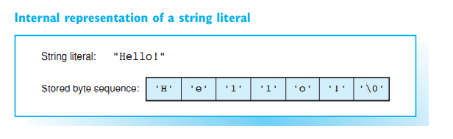
String Constants
You already know string constants, which were introduced for text output using the cout stream. A string constant consists of a sequence of characters enclosed in double quotes
EXAMPLE: "Today is a beautiful day!"
A string constant is stored internally without the quotes but terminated with a null character, \0, represented by a byte with a numerical value of 0 — that is, all the bits in this byte are set to 0. Thus, a string occupies one byte more in memory than the number of characters it contains.
An empty string, "", therefore occupies a single byte. The terminating null character \0 is not the same as the number zero and has a different character code than zero.
Thus, the string "0" comprises two bytes, the first byte containing the code for the character zero 0 (ASCII code 48) and the second byte the value 0. The terminating null character \0 is an example of an escape sequence.

Slide 18
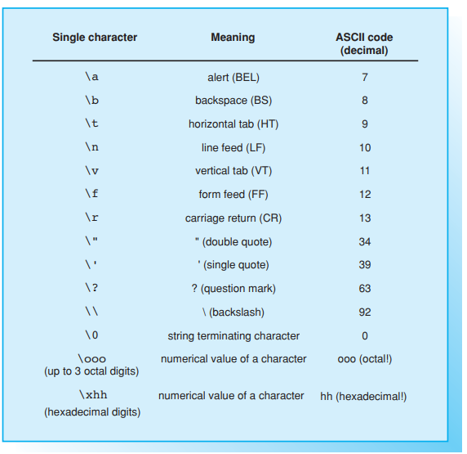
Escape sequences
Nongraphic characters can be expressed by means of escape sequences, for example \t, which represents a tab.
The effect of an escape sequence will depend on the device concerned. The sequence \t, for example, depends on the setting for the tab width, which defaults to eight blanks but can be any value.
An escape sequence always begins with a \ (backslash) and represents a single character. The table shows the standard escape sequences, their decimal values, and effects. You can use octal and hexadecimal escape sequences to create any character code. Thus, the letter A (decimal 65) in ASCII code can also be expressed as \101 (three octals) or \x41 (two hexadecimals). Traditionally, escape sequences are used only to represent non-printable characters and special characters. The control sequences for screen and printer drivers are, for example, initiated by the ESC character (decimal 27), which can be represented as \33 or \x1b.
Escape sequences are used in character and string constants.

Slide 19
Escape sequences
EXAMPLES: '\t' "\tHello\n\tMike!"
The characters ', ", and \ have no special significance when preceded by a backslash, i.e. they can be represented as \', \", and \\ respectively.
When using octal numbers for escape sequences in strings, be sure to use three digits, for example, \033 and not \33. This helps to avoid any subsequent numbers being evaluated as part of the escape sequence. There is no maximum number of digits in a hexadecimal escape sequence. The sequence of hex numbers automatically terminates with the first character that is not a valid hex number.
The sample program on the opposite page demonstrates the use of escape sequences in strings. The fact that a string can occupy two lines is another new feature. String constants separated only by white spaces will be concatenated to form a single string.
To continue a string in the next line you can also use a backslash \ as the last character in a line, and then press the Enter key to begin a new line, where you can continue typing the string

Slide 20
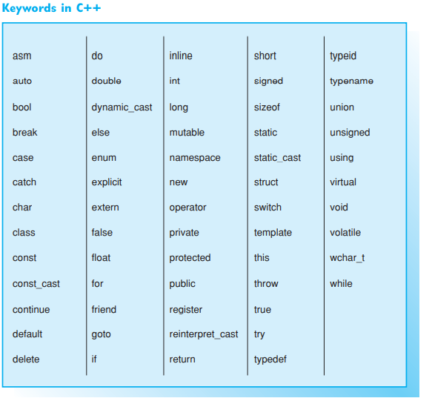
names

Slide 21
Valid names
Within a program names are used to designate variables and functions. The following rules apply when creating names, which are also known as identifiers:
a name contains a series of letters, numbers, or underscore characters ( _ ). German umlauts and accented letters are invalid. C++ is case sensitive; that is, upper- and lowercase letters are different.
the first character must be a letter or underscore
there are no restrictions on the length of a name and all the characters in the name are significant
C++ keywords are reserved and cannot be used as names.
The C++ compiler uses internal names that begin with one or two underscores followed by a capital letter. To avoid confusion with these names, avoid use of the underscore at the beginning of a name. Under normal circumstances the linker only evaluates a set number of characters, for example, the first 8 characters of a name.
For this reason names of global objects, such as functions, should be chosen so that the first eight characters are significant.

Slide 22
conventions
In C++ it is standard practice to use small letters for the names of variables and functions. The names of some variables tend to be associated with a specific use:
c, ch for characters
i, j, k l, m, n for integers, in particular indices
x, y, z for floating-point numbers
To improve the readability of your programs you should choose longer and more self-explanatory names, such as start_index or startIndex for the first index in a range of index values.
In the case of software projects, naming conventions will normally apply. For example, prefixes that indicate the type of the variable may be assigned when naming variables

Slide 23
Defining variables
A variable must be defined before you can use it in a program. When you define a variable the type is specified and an appropriate amount of memory reserved. This memory space is addressed by reference to the name of the variable. A simple definition has the following syntax:
SYNTAX: typ name1 [name2 … ];
This defines the names of the variables in the list name1 [, name2 ...] as variables of the type type. The parentheses [ ... ] in the syntax description indicate that this part is optional and can be omitted. Thus, one or more variables can be stated within a single definition.

Slide 24
variables
EXAMPLES:
char c;
int i, counter;
double x, y, size;
In a program, variables can be defined either within the program’s functions or outside of them. This has the following effect:
a variable defined outside of each function is global, i.e. it can be used by all functions
a variable defined within a function is local, i.e. it can be used only in that function.
Local variables are normally defined immediately after the first brace—for example at the beginning of a function. However, they can be defined wherever a statement is permitted. This means that variables can be defined immediately before they are used by the program

Slide 25
initialization
A variable can be initialized, i.e. a value can be assigned to the variable, during its definition. Initialization is achieved by placing the following immediately after the name of the variable:
an equals sign ( = ) and an initial value for the variable or
round brackets containing the value of the variable.
EXAMPLES:
char c = 'a';
float x(1.875);
Any global variables not explicitly initialized default to zero. In contrast, the initial value for any local variables that you fail to initialize will have an undefined initial value

Slide 26
The keywords const and volatile - Constant objects
The const keyword is used to create a “read only” object. As an object of this type is constant, it cannot be modified at a later stage and must be initialized during its definition.
EXAMPLE:
const double pi = 3.1415947;
Thus the value of pi cannot be modified by the program. Even a statement such as the following will merely result in an error message:
pi = pi + 2.0; // invalid

Slide 27
Volatile objects
The keyword volatile, which is rarely used, creates variables that can be modified not only by the program but also by other programs and external events. Events can be initiated by interrupts or by a hardware clock, for example.
EXAMPLE:
volatile unsigned long clock_ticks;
Even if the program itself does not modify the variable, the compiler must assume that the value of the variable has changed since it was last accessed. The compiler therefore creates machine code to read the value of the variable whenever it is accessed instead of repeatedly using a value that has been read at a prior stage.
It is also possible to combine the keywords const and volatile when declaring a variable.
EXAMPLE:
volatile const unsigned time_to_live;
Based on this declaration, the variable time_to_live cannot be modified by the program but by external events.

Slide 28
exercises

